Slide 1




Predicting customer buying behaviour

Slide 2
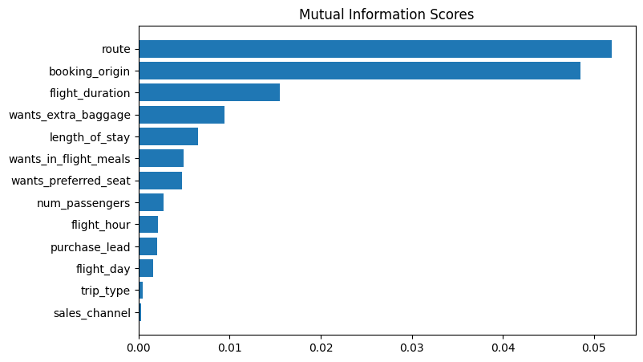
Among the two training models used, XGBoost has the highest level of training accuracy. Therefore, XGBoost is used to validate with test data and the results are:
ACCURACY: 85.19
AUC score: 0.540
Here’s the top 5 features which influence customer buying behavior:
route
booking_origin
flight_duration
wants_extra_baggage
length_of_stay
We need to increase the AUC score.

